Slide 1
GBM Package in R
7/24/2014

Slide 2
Presentation Outline
Algorithm Overview
Basics
How it solves problems
Why to use it
Deeper investigation while going through live code

Slide 3
What is GBM?
Predictive modeling algorithm
Classification & Regression
Decision tree as a basis*
Boosted
Multiple weak models combined algorithmically
Gradient boosted
Iteratively solves residuals
Stochastic
(some additional references on last slide)
* technically, GBM can take on other forms such as linear, but decision trees are the dominant usage, Friedman specifically optimized for trees, and R’s implementation is internally represented as a tree

Slide 4
Predictive Modeling Landscape: General Purpose Algorithms (for illustrative purposes only, not to scale, precise, or comprehensive; author’s perspective)
Random Forest
(randomForest)
Gradient Boosted Machines (gbm)
Neural Networks (nnet)
Support Vector Machines (kernlab)
Regularized
Linear
Models
(glmnet)
Splines (earth)
complexity
Naïve Bayes (klaR)
Generalized Linear Models (glm)
Classification
And Regression Trees (rpart)
Nearest Neighbor (kNN)
Linear Models (lm)
Linear Models
Decision Trees
Others
More Comprehensive List: http://caret.r-forge.r-project.org/modelList.html

Slide 5
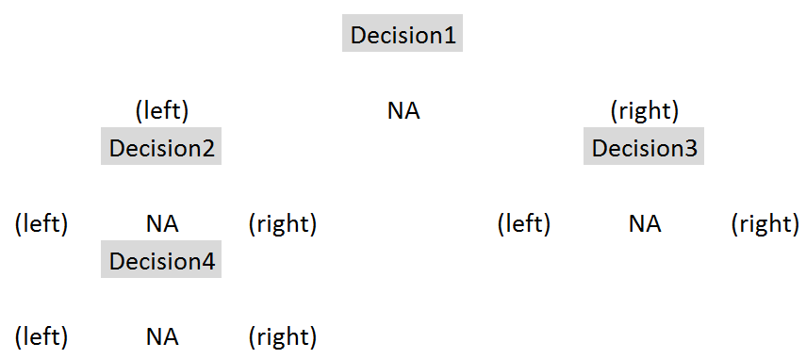
GBM’s decision tree structure

Slide 6
Why GBM?
Characteristics
Competitive Performance
Robust
Loss functions
Fast (relatively)
Usages
Quick modeling
Variable selection
Final-stage precision modeling

Slide 7
Competitive Performance
Competitive with high-end algorithms such as RandomForest
Reliable performance
Avoids nonsensical predictions
Rare to produce worse predictions than simpler models
Often in winning Kaggle solutions
Cited within winning solution descriptions in numerous competitions, including $3M competition
Many of the highest ranked competitors use it frequently
Used in 4 of 5 personal top 20 finishes

Slide 8
Robust
Explicitly handles NAs
Scaling/normalization is unnecessary
Handles more factor levels than random forest (1024 vs 32)
Handles perfectly correlated independent variables
No [known] limit to number of independent variables

Slide 9
Loss Functions
Gaussian: squared loss
Laplace: absolute loss
Bernoulli: logistic, for 0/1
Huberized: hinge, for 0/1
Adaboost: exponential loss, for 0/1
Multinomial: more than one class (produces probability matrix)
Quantile: flexible alpha (e.g. optimize for 2 StDev threshold)
Poisson: Poisson distribution, for counts
CoxPH: Cox proportional hazard, for right-censored
Tdist: t-distribution loss
Pairwise: rankings (e.g. search result scoring)
Concordant pairs
Mean reciprocal rank
Mean average precision
Normalized discounted cumulative gain

Slide 10
Drawbacks
Several hyper-parameters to tune
I typically use roughly the same parameters to start, unless I suspect the data set might have peculiar characteristics
For creating a final model, tuning several parameters is advisable
Still has capacity to overfit
Despite internal cross-validation, it is still particularly prone to overfit ID-like columns (suggestion: withhold them)
Can have trouble with highly noisy data
Black box
However, GBM package does provide tools to analyze the resulting models

Slide 11
Deeper Analysis via Walkthrough
Hyper-parameter explanations (some, not all)
Quickly analyze performance
Analyze influence of variables
Peek under the hood…then follow a toy problem
For those not attending the presentation, the code at the back is run at this point and discussed. The remaining four slides were mainly to supplement the discussion of the code and comments, and there was not sufficient time.

Slide 12
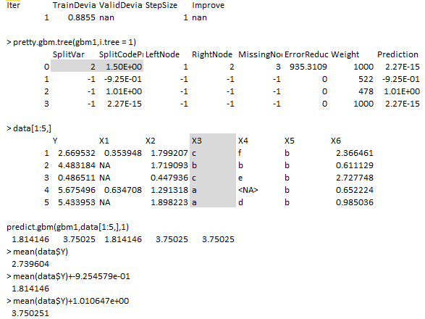
Same analysis with a simpler data set
Note that one can recreate the predictions of this first tree by finding the terminal node for any prediction and using the Prediction value (final column in data frame). Those values for all desired trees, plus the initial value (mean for this) is the prediction.
Matches predictions 1 & 3
Matches predictions 2,4 & 5

Slide 13
Same analysis with a simpler data set
Explanation
1 tree built.
Tree has one decision only, node 0.
Node 0 indicates it split the 3rd field (SplitVar:2), to where values below 1.5
(ordered values 0 & 1 which are a & b) went to node 1; values above
1.5 (2/3 = c/d) went to node 2; missing (none) go to node 3.
Node 1 (X3=A/B) is a terminal node (SplitVar -1) and it predicts the mean plus -0.925.
Node 2 (X3=C/D) is a terminal node and it predicts the mean plus 1.01.
Node 3 (none) is a terminal node and it predicts the mean plus 0, effectively.
Later saw that gbm1$initF will show the intercept, which in this case is the mean.

Slide 14
GBM predict: fit a GBM to data
gbm(formula = formula(data),
distribution = "bernoulli",
n.trees = 100,
interaction.depth = 1,
n.minobsinnode = 10,
shrinkage = 0.001,
bag.fraction = 0.5,
train.fraction = 1.0,
cv.folds=0,
weights,
data = list(),
var.monotone = NULL,
keep.data = TRUE,
verbose = "CV",
class.stratify.cv=NULL,
n.cores = NULL)

Slide 15
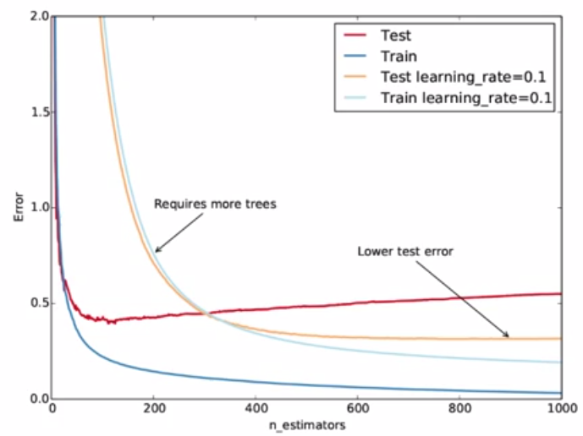
Effect of shrinkage & trees
Source: https://www.youtube.com/watch?v=IXZKgIsZRm0 (GBM explanation by SciKit author)

Slide 16
Code Dump
The code has been copied from a text R script into PowerPoint, so the format isn’t great, but it should look OK if copying and pasting back out to a text file. If not, here it is on Github.
The code shown uses a competition data set that is comparable to real world data and uses a simple GBM to predict sale prices of construction equipment at auction.
A GBM model was fit against 100k rows with 45-50 variables in about 2-4 minutes during the presentation. It improves the RMSE of prediction against the mean from ~24.5k to ~9.7k, when scored on data the model had not seen (and future dates, so the 100k/50k splits should be valid), with fairly stable train:test performance.
After predictions are made and scored, some GBM utilities are used to see which variables the model found most influential, see how the top 2 variables are used (per factor for one; throughout a continuous distribution for the other), and see interaction effects of specific variable pairs.
Note: GBM was used by my teammate and I to finish 12th out of 476 in this competition (albeit a complex ensemble of GBMs)

Slide 17
Code Dump: Page1
library(Metrics) ##load evaluation package
setwd("C:/Users/Mark_Landry/Documents/K/dozer/")
##Done in advance to speed up loading of data set
train<-read.csv("Train.csv")
## Kaggle data set: http://www.kaggle.com/c/bluebook-for-bulldozers/data
train$saleTransform<-strptime(train$saledate,"%m/%d/%Y %H:%M")
train<-train[order(train$saleTransform),]
save(train,file="rTrain.Rdata")
load("rTrain.Rdata")
xTrain<-train[(nrow(train)-149999):(nrow(train)-50000),5:ncol(train)]
xTest<-train[(nrow(train)-49999):nrow(train),5:ncol(train)]
yTrain<-train[(nrow(train)-149999):(nrow(train)-50000),2]
yTest<-train[(nrow(train)-49999):nrow(train),2]
dim(xTrain); dim(xTest)
sapply(xTrain,function(x) length(levels(x)))
## check levels; gbm is robust, but still has a limit of 1024 per factor; for initial model, remove
## after iterating through model, would want to go back and compress these factors to investigate
## their usefulness (or other information analysis)
xTrain$saledate<-NULL; xTest$saledate<-NULL
xTrain$fiModelDesc<-NULL; xTest$fiModelDesc<-NULL
xTrain$fiBaseModel<-NULL; xTest$fiBaseModel<-NULL
xTrain$saleTransform<-NULL; xTest$saleTransform<-NULL

Slide 18
Code Dump: Page2
library(gbm)
## Set up parameters to pass in; there are many more hyper-parameters available, but these are the most common to control
GBM_NTREES = 400
## 400 trees in the model; can scale back later for predictions, if desired or overfitting is suspected
GBM_SHRINKAGE = 0.05
## shrinkage is a regularization parameter dictating how fast/aggressive the algorithm moves across the loss gradient
## 0.05 is somewhat aggressive; default is 0.001, values below 0.1 tend to produce good results
## decreasing shrinkage generally improves results, but requires more trees, so the two should be adjusted in tandem
GBM_DEPTH = 4
## depth 4 means each tree will evaluate four decisions;
## will always yield [3*depth + 1] nodes and [2*depth + 1] terminal nodes (depth 4 = 9)
## because each decision yields 3 nodes, but each decision will come from a prior node
GBM_MINOBS = 30
## regularization parameter to dictate how many observations must be present to yield a terminal node
## higher number means more conservative fit; 30 is fairly high, but good for exploratory fits; default is 10
## Fit model
g<-gbm.fit(x=xTrain,y=yTrain,distribution = "gaussian",n.trees = GBM_NTREES,shrinkage = GBM_SHRINKAGE,
interaction.depth = GBM_DEPTH,n.minobsinnode = GBM_MINOBS)
## gbm fit; provide all remaining independent variables in xTrain; provide targets as yTrain;
## gaussian distribution will optimize squared loss;

Slide 19
Code Dump: Page3
## get predictions; first on train set, then on unseen test data
tP1 <- predict.gbm(object = g,newdata = xTrain,GBM_NTREES)
hP1 <- predict.gbm(object = g,newdata = xTest,GBM_NTREES)
## compare model performance to default (overall mean)
rmse(yTrain,tP1) ## 9452.742 on data used for training
rmse(yTest,hP1) ## 9740.559 ~3% drop on unseen data; does not seem to be overfit
rmse(yTest,mean(yTrain)) ## 24481.08 overall mean; cut error rate (from perfection) by 60%
## look at variables
summary(g) ## summary will plot and then show the relative influence of each variable to the entire GBM model (all trees)
## test dominant variable mean
library(sqldf)
trainProdClass<-as.data.frame(cbind(as.character(xTrain$fiProductClassDesc),yTrain))
testProdClass<-as.data.frame(cbind(as.character(xTest$fiProductClassDesc),yTest))
colnames(trainProdClass)<-c("fiProductClassDesc","y"); colnames(testProdClass)<-c("fiProductClassDesc","y")
ProdClassMeans<-sqldf("SELECT fiProductClassDesc,avg(y) avg, COUNT(*) n FROM trainProdClass GROUP BY fiProductClassDesc")
ProdClassPredictions<-sqldf("SELECT case when n > 30 then avg ELSE 31348.63 end avg
FROM ProdClassMeans P LEFT JOIN testProdClass t ON t.fiProductClassDesc = P.fiProductClassDesc")
rmse(yTest,ProdClassPredictions$avg) ## 29082.64 ? peculiar result on the fiProductClassDesc means, which seemed fairly stable and useful
##seems to say that the primary factor alone is not helpful; full tree needed

Slide 20
Code Dump: Page4
## Investigate actual GBM model
pretty.gbm.tree(g,1) ## show underlying model for the first decision tree
summary(xTrain[,10]) ## underlying model showed variable 9 to be first point in tree (9 with 0 index = 10th column)
g$initF ## view what is effectively the "y intercept"
mean(yTrain) ## equivalence shows gaussian y intercept is the mean
t(g$c.splits[1][[1]]) ## show whether each factor level should go left or right
plot(g,10) ## plot fiProductClassDesc, the variable with the highest rel.inf
plot(g,3) ## plot YearMade, continuous variable with 2nd highest rel.inf
interact.gbm(g,xTrain,c(10,3))
## compute H statistic to show interaction; integrates
interact.gbm(g,xTrain,c(10,3))
## example of uninteresting interaction

Slide 21
Selected References
CRAN
Documentation
vignette
Algorithm publications:
Greedy function approximation: A gradient boosting machine Friedman 2/99
Stochastic Gradient Boosting; Friedman 3/99
Overviews
Gradient boosting machines, a tutorial: Frontiers (4/13)
Wikipedia (pretty good article, really)
Video of author of GBM in Python: Gradient Boosted Regression Trees in scikit-learn
Very helpful, but the implementation is not decision “stumps” in R, so some things are different in R (e.g. number of trees need not be so high)

